Slide 1

“The Two-Hour Job Search”
The Informational Interview

Slide 2
First, What is an Informational Interview?
A conversation between an information “seeker” (YOU) and an information “keeper” (CONTACT).
You lead the conversation to obtain:
    The Contact’s career path & how he/she landed with current firm
    Relevant information on the firm
The Goal of the Informational Interview:
  Gain a Connection (most important – primary focus)
  Gain Information (secondary focus)

Slide 3
Types of Alum
“All Alum are NOT Created Equal”
There are three types of Alumni:
  “Curmudgeons” – they will not help you
  “Obligates” motivated by guilt, they will help you at a minimum level
  “Boosters” – motivated by a deep desire to help, they will really go to bat for you
The Challenge: Identify quickly which Alum type you are dealing with.
We want Boosters advocating for us!

Slide 4
Key Points in Contacting Alum
When contacting an Alum you are going to commit to TWO things:
  The conversation will be about their experience and insights, not jobs
  You will promise to follow up with updates on progress
Emailing Alum
Use the “Five Point Email” Formula:
  - Fewer than 100 words
  - No mention of jobs anywhere (subject or body)
  - Connection goes first
  - Generalize your interest
  - Maintain control and follow up

Slide 5
Key Points in Contacting Alum
Initial Email Example
Subject: BYU Finance Student seeking your advice
Dear Mr. Jones,
My name is Ryan Smith, and I am a first year BYU MBA student who found your information on LinkedIn. May I have 20 minutes to ask you about your experience with IBM? I am trying to learn more about marketing careers at technology companies in North Carolina, and your insights would be very helpful.
I recognize this may be a busy time for you, so if we are unable to connect by email I’ll try to reach you next week to see whether that is more convenient.
Thank you for your time,
Ryan

Slide 6
The Informational Interview
A Three-Step Process
Steps | Time Required
Research | 15 minutes
Discuss | 30 minutes
Follow up | Ongoing
Total For Information Interviewing | 45 minutes per Interview
Simple, Easy, and Time-Efficient Process

Slide 7
Step 1: External Research (15 min)
Research
Company SWOT Analysis: Summary of a firm’s Strengths, Weaknesses, Opportunities, Threats
  http://lib.byu.edu/guides
    Scroll down and select “Business Management”
    Select “Company and Industry Research” Tab in menu
    Select “Business Source Premier” Link
    Select “Company Profiles”
    Type in name of firm desired
    Open MarketLine PDF File for firm
    Select from menu on left hand side “SWOT”
Headlines from Company Website
“Google” Company and Interviewers
At a minimum, make sure to check these three references

Slide 8
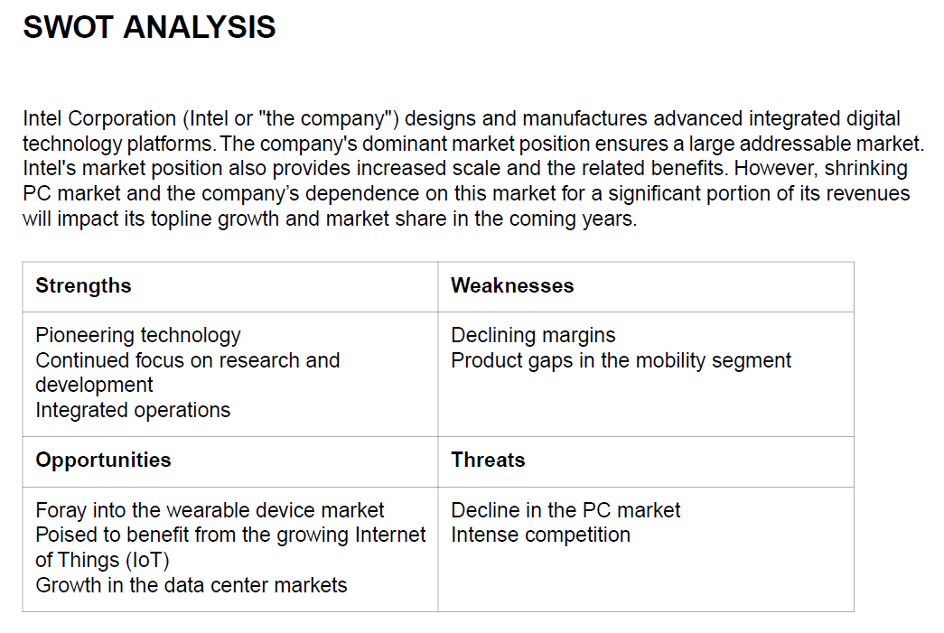
SWOT Analysis Example
MarketLine Report - Intel
Research
High Level SWOT
The report drills down in detail for each area (not shown)
Scroll down in the tool to view detail

Slide 9
Step 2 - Discussion
Discussion
Hold the conversation
The Focus of the conversation is about the Contact – not you!
The Goal – to get the Contact to trust you enough that they will go to bat for you inside the organization!
There are 3 simple phases:
  Phase 1: Small Talk
  Phase 2: Q&A
  Phase 3: Next Steps

Slide 10
General Principles
Discussion
Take a Genuine Interest in your Contact
  Fakes can be seen right through
“Follow the energy” – go where the contact shows energy
  If contact doesn’t sound interested, move to the next step (Q&A)
Mirror the topics and demeanor of your contact
  If they talk about hobbies, then you do. If they don’t, then you don’t
  If they take 30 seconds to answer a question, then you do, and no longer.
  Never take more than 2 minutes to answer a question – even if they take 5 minutes.

Slide 11
Phase 1: Small Talk
Discussion
Some Small Talk Questions:
  How is your day going today? (Shows you are they chatty or down to business?)
  What Projects are you working on right now? (Shows interest in the type of work he/she does, and helps you gauge his/her passion)
  Would you tell me a bit about your background, and how you came to work for Company X? (Another gauge on all business, or personable? How does the person answer it (non-verbal queues)
Primary Goal with Small Talk – Build Rapport (connection)

Slide 12
Transition to Q&A
Discussion
A transition statement from Small Talk to the Q&A Phase:
  “Thank you again for your time. I did prepare a few questions for you, so I’m hoping I could ask them now.”

Slide 13
Phase 2: Q&A – The TIARA Method
Discussion
TIARA & Sample Questions:
  Trends: What trends are impacting your business right now?
  Insights: What surprises you most about your job?
  Advice: What can I do right now to best prepare for a career in this field?
  Resources: What resources should I look into next?
  Assignments: Which projects are most common/important in your work?
Framework Goal: Questions shift in tone and depth to turn the contact from a stranger into an advocate!

Slide 14
TIARA - Resources
Discussion
If the Booster gives you a referral:
  Thank the Booster!
  Obligate yourself that you will follow up with him/her and let her know progress
  Initiate contact with the referral immediately
  Set a reminder to follow up with the Booster in two weeks
If no referrals are given:
  Remember – the contact needs to trust you before they will offer
  If they ask you what resources you are looking for you can use any of these:
    “What resources – for example, websites, blogs, magazines, etc. do you read regularly to keep current in your industry?”
    “What is the most important 10 minutes of research you do each day to stay on top of trends impacting your business?”
    “If I wanted to learn the language of the industry – acronyms, and specific terminology, what resources do you think might prove most helpful?

Slide 15
Phase 3 - Next Steps
Next Steps
If you got a referral – Congrats, you know what to do!
If you did not get a referral – use the “Two Step Close” process:
  “Our time is up, but thank you so much for your time today – you’ve given me a lot to think about, and it sounds like you’re working for a great organization.
  I’m going to take a few days to process all of the information you’ve shared. If, on reflection, it seems like your organization and I may make a good mutual fit, is it OK to reach back out to you to get your recommendations for how best to proceed from here?”
  If he/she gives you anything to do…do it!
When you follow up a few days later, and still they are stonewalling, you can then ask:
  “Is there anyone else in the organization you could recommend I speak to in order to build my network there?”
  There is nothing to lose now – you are down to your last straw – go for it!

